Slide 1


Harshavardhan
26/04/2023

Slide 2

Outline
Executive Summary
Introduction
Methodology
Results
Conclusion
Appendix

Slide 3
Executive Summary
Summary of methodologies
Data collection using web scrapping and SpaceX APIs
Exploratory Data Analysis (EDA), including data wrangling, data visualization and interactive visual analytics.
Prediction using Machine Learning models.
Summary of all results
It was possible to collect valuable data from public sources.
EDA allows us to identify features that are best to predict success of landing.
Using machine learning models, we can predict the success rate with more than 80% accuracy.

Slide 4
Introduction
Project background and context
The objective is to predict the success rate of launches for new company spaceY to compete with spaceX
Problems you want to find answers
The best way to estimate the total cost for launches, by predicting the success rate of first stage rockets landing
Where is the best place to make launches.

Slide 5

Section 1

Slide 6
Methodology
Executive Summary
Data collection methodology:
Data is obtained from 2 sources:
Space X API(https://api.spacexdata.com/v4/rockets/)
Web scraping the Wikipedia page.
Perform data wrangling
Data wrangling and cleaning was done using pandas and numpy libraries
Perform exploratory data analysis (EDA) using visualization and SQL
Perform interactive visual analytics using Folium and Plotly Dash

Slide 7
Methodology
Executive Summary
Perform predictive analysis using classification models
Data was normalized, divided into training and testing sets and evaluated by 4 different classification models.

Slide 8
Data Collection
Describe how data sets were collected.
Data is obtained from 2 sources:
Space X API(https://api.spacexdata.com/v4/rockets/)
Web scraping the Wikipedia page.

Slide 9
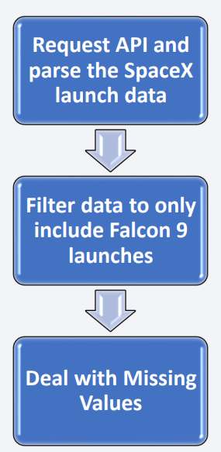
Data Collection – SpaceX API
Public API can be used to get the data.
The data can be loaded according to the flow chart.
Code: https://github.com/harshalingala/datascience_capstone_project/blob/main/jupyter-labs-spacex-data-collection-api.ipynb

Slide 10
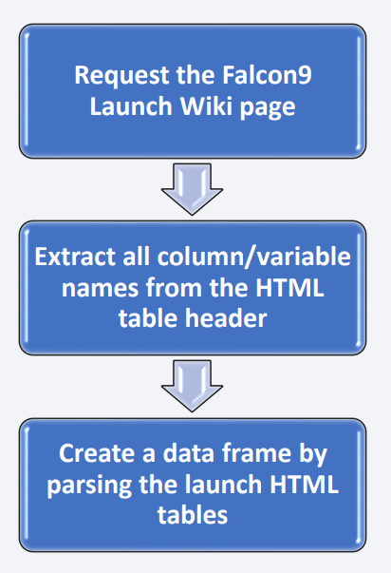
Data Collection - Scraping
Wikipedia contains the launch data, web scraping can be used to get the data.
Code: https://github.com/harshalingala/datascience_capstone_project/blob/main/jupyter-labs-webscraping.ipynb

Slide 11
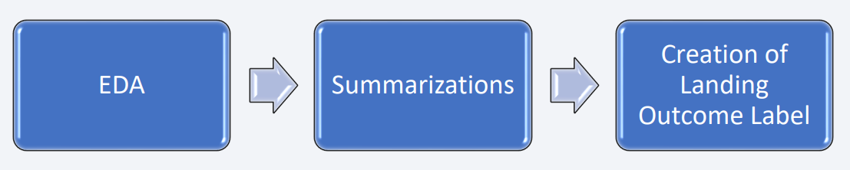
Data Wrangling
Some Exploratory data analysis is performed on the data.
Summaries of launch site, success rate of mission outcome per orbit are calculated.
Finally landing outcome column was created.
Code: https://github.com/harshalingala/datascience_capstone_project/blob/main/jupyter-labs-spacex-data_wrangling_jupyterlite.jupyterlite.ipynb

Slide 12
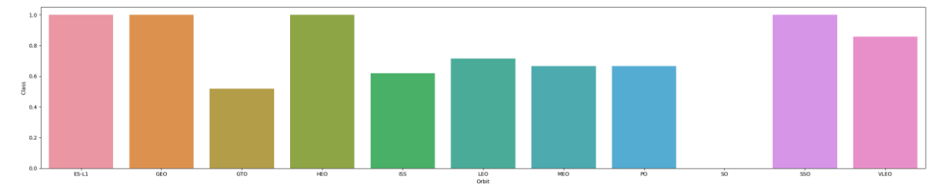
EDA with Data Visualization
Scatter and bar plots were used to visualize the data to establish relationship between features
Below image is success rate w.r.t orbit.
Code: https://github.com/harshalingala/datascience_capstone_project/blob/main/jupyter-labs-eda-dataviz.ipynb.jupyterlite.ipynb

Slide 13
EDA with SQL
The following tasks were performed using SQL:
Display launch site names
Top 5 launch sites whose names begins with ‘CCA’
Display the total pay load mass carried by boosters launched by NASA
Display average pay load mass launched by booster version F9 v1.1
List the date when the first successful landing outcome in the ground pad was performed
List the names of boosters which have success in drone ship and have pay load mass between 4000 and 6000
List the total number of successful and failure mission outcomes
List the names of the booster_versions that carried maximum payload mass
List the records which display the month names, failure landing outcomes in drone ship, booster version, launch site for the months in 2015
Count of successful landing outcomes between 04-06-2010 and 20-03-2017 in descending order
Code: https://github.com/harshalingala/datascience_capstone_project/blob/main/jupyter-labs-eda-sql-coursera_sqllite.ipynb

Slide 14
Build an Interactive Map with Folium
Markers, circles, lines and marker clusters were used with folium maps:
Markers indicate points like launch sites
Circles highlight the area of interest
Marker cluster group if events like launches in launch sites
Lines are used to indicate distances between two points.
Code: https://github.com/harshalingala/datascience_capstone_project/blob/main/Jupyter-labs-analysis_with_folium.ipynb

Slide 15
Build a Dashboard with Plotly Dash
The following graphs and plots were used to visualize data
Percentage of launches by site
Payload range
This combination allows us to quickly analyze the relationship between payloads and launch sites, helping to identify best places for the launch according to payload.
Code: https://github.com/harshalingala/datascience_capstone_project/blob/main/spacex_dash_app.py

Slide 16
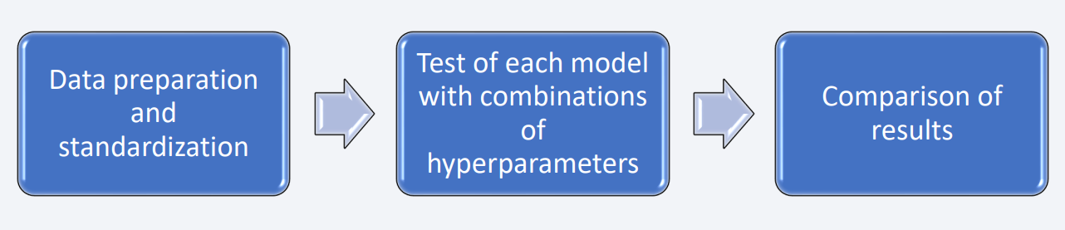
Predictive Analysis (Classification)
Four classification models were evaluated: logistical regression, support vector machine, decision tree and k nearest neighbors.
Code:https://github.com/harshalingala/datascience_capstone_project/blob/main/SpaceX_Machine_Learning_Prediction_Part_5.jupyterlite.ipynb

Slide 17
Results
Exploratory data analysis results
spaceX uses 4 different launch sites
Average load for F9 v1.1 booster is 2928KG
Many falcon 9 landing were successful at landing in drone ships having pay load above 4000KG
There are 2 failures in 2015
The success rate improved over years

Slide 18
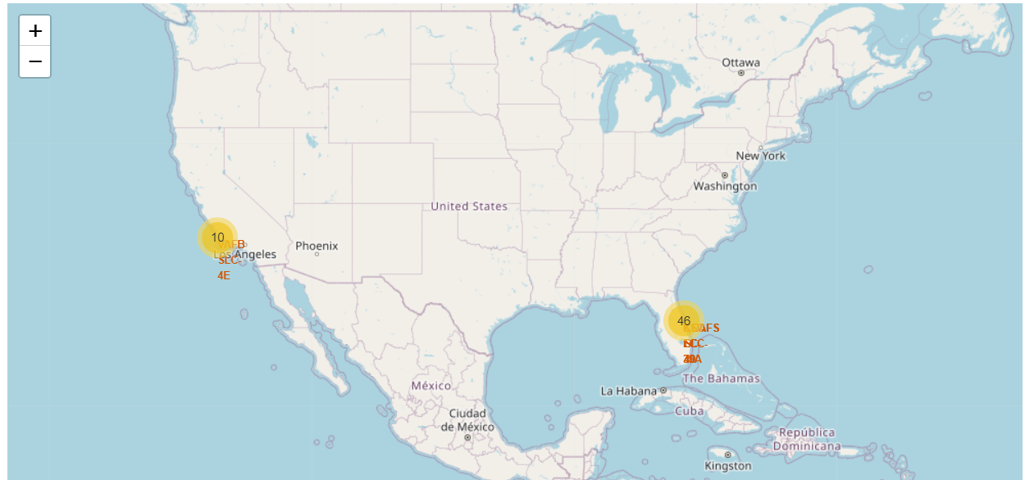
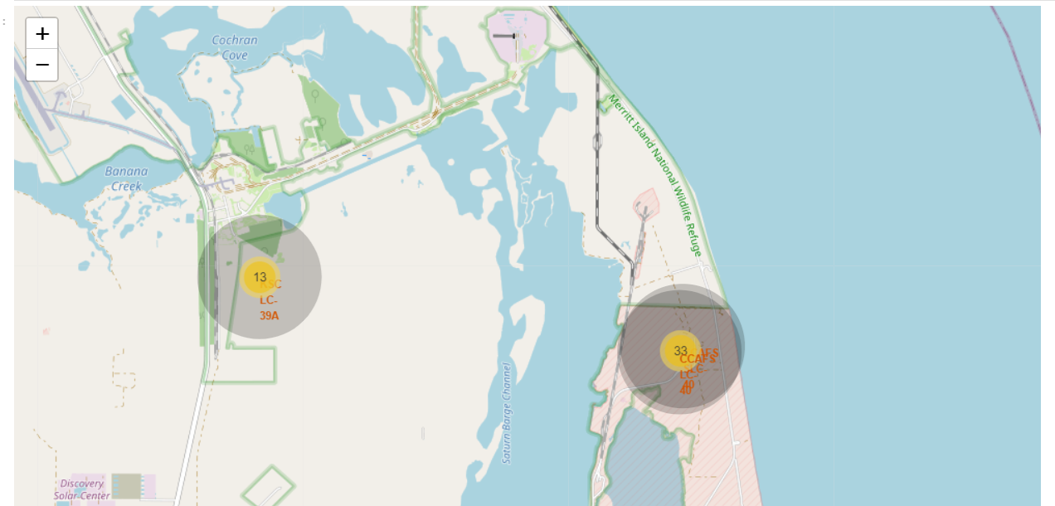
Results
Using interactive analytics, it was possible to identify that the launch sites are in safe places, near sea and have good infrastructure around
Most launches happen at east coast

Slide 19
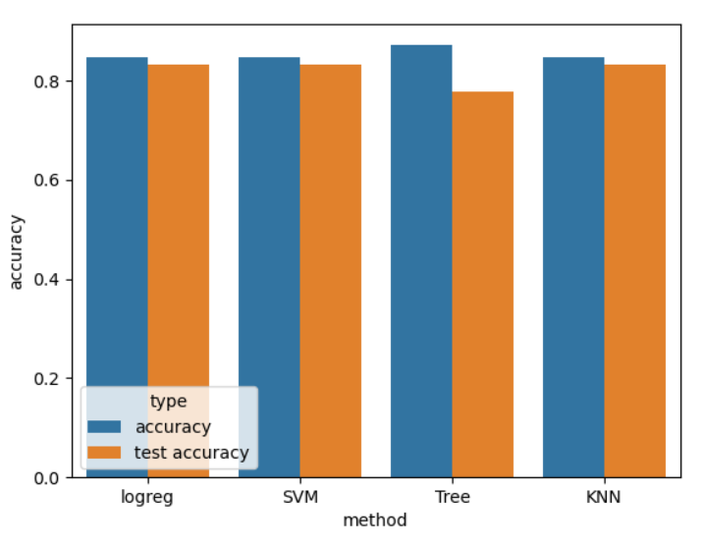
Results
Predictive analysis show that all models are closer in their performance.
Tree classification have higher training accuracy and lower test accuracy suggesting a overfitting.

Slide 20

Section 2

Slide 21
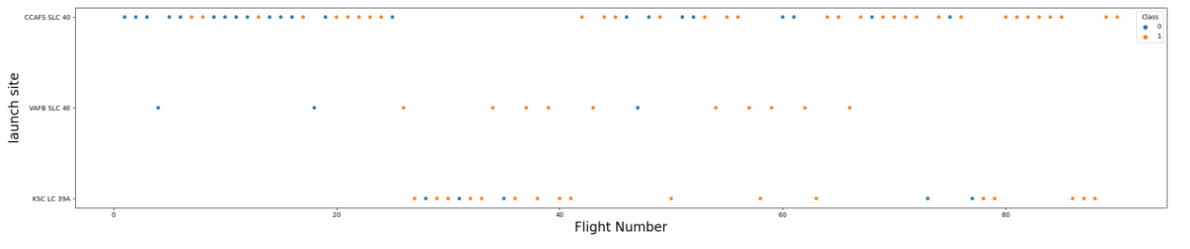
Flight Number vs. Launch Site
It is possible to notice CCAF5 SLC 40 is best launch site with most of recent launches being successful.
It is possible to see increase in success rate with time.

Slide 22
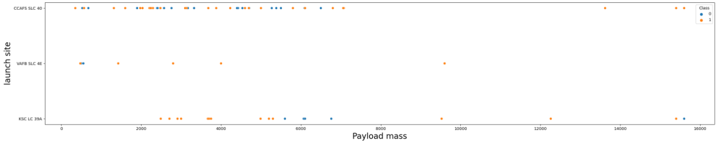
Payload vs. Launch Site
Payloads over 9,000kg (about the weight of a school bus) have excellent success rate;
Payloads over 12,000kg seems to be possible only on CCAFS SLC 40 and KSC LC 39A launch sites.

Slide 23
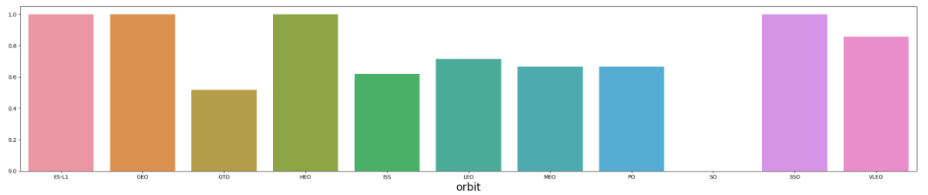
Success Rate vs. Orbit Type
ES-L1, GEO, HEO and SSO orbits have biggest success rate.

Slide 24
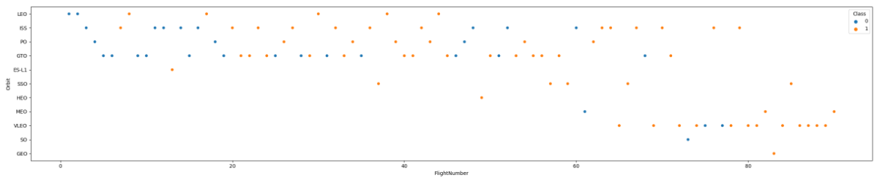
Flight Number vs. Orbit Type
Success rate improves for all orbits over time.

Slide 25
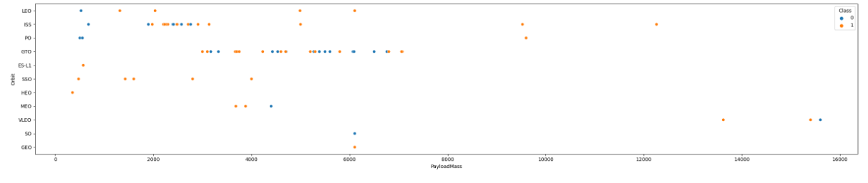
Payload vs. Orbit Type
The launches for SO and GEO are low.
For GTO, no good correlation between pay load mass and success rate.

Slide 26
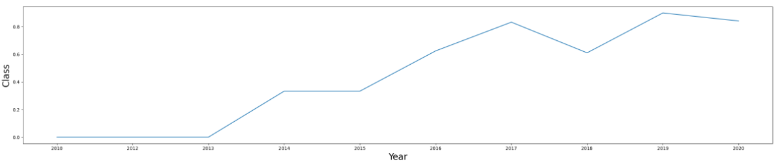
Launch Success Yearly Trend
Success rate shows improvement over the years.

Slide 27
All Launch Site Names
Following are the 4 launch sites
Launch_Site
CCAFS LC-40
CCAFS SLC-40
KSC LC-39A
VAFB SLC-4E

Slide 28
Launch Site Names Begin with 'CCA'
The query was able to complete using LIKE operator.
Below are the 5 records for launch sites beginning with ‘CCA’
Date | Time (UTC) | Booster_Version | Launch_Site | Payload | PAYLOAD_MASS__KG_ | Orbit | Customer | Mission_Outcome | Landing _Outcome
04-06-2010 | 18:45:00 | F9 v1.0 B0003 | CCAFS LC-40 | Dragon Spacecraft Qualification Unit | 0 | LEO | SpaceX | Success | Failure (parachute)
08-12-2010 | 15:43:00 | F9 v1.0 B0004 | CCAFS LC-40 | Dragon demo flight C1, two CubeSats, barrel of Brouere cheese | 0 | LEO (ISS) | NASA (COTS) NRO | Success | Failure (parachute)
22-05-2012 | 07:44:00 | F9 v1.0 B0005 | CCAFS LC-40 | Dragon demo flight C2 | 525 | LEO (ISS) | NASA (COTS) | Success | No attempt
08-10-2012 | 00:35:00 | F9 v1.0 B0006 | CCAFS LC-40 | SpaceX CRS-1 | 500 | LEO (ISS) | NASA (CRS) | Success | No attempt
01-03-2013 | 15:10:00 | F9 v1.0 B0007 | CCAFS LC-40 | SpaceX CRS-2 | 677 | LEO (ISS) | NASA (CRS) | Success | No attempt

Slide 29
Total Payload Mass
Total pay load mass for NASA is more than 45000 KGs
SUM(PAYLOAD_MASS__KG_) | Customer
45596 | NASA (CRS)

Slide 30
Average Payload Mass by F9 v1.1
Average pay load mass for F9 v1.1 is ~2900KGs
AVG(PAYLOAD_MASS__KG_) | Booster_Version
2928.4 | F9 v1.1

Slide 31
First Successful Ground Landing Date
First successful landing outcome on ground pad was in 2015
Min Date
2015-12-22

Slide 32
Successful Drone Ship Landing with Payload between 4000 and 6000
Here are the boosters the successfully landed on drone ship with pay load between 4000 and 6000
Booster_Version
F9 FT B1022
F9 FT B1026
F9 FT B1021.2
F9 FT B1031.2

Slide 33
Total Number of Successful and Failure Mission Outcomes
Here is the mission success and fail report
COUNT(*) | Mission_Outcome
1 | Failure (in flight)
98 | Success
1 | Success
1 | Success (payload status unclear

Slide 34
Boosters Carried Maximum Payload
Here are the list of booster version that carried maximum load
Booster_Version
F9 B5 B1048.4
F9 B5 B1048.5
F9 B5 B1049.4
F9 B5 B1049.5
F9 B5 B1049.7
F9 B5 B1051.3
F9 B5 B1051.4
F9 B5 B1051.6
F9 B5 B1056.4
F9 B5 B1058.3
F9 B5 B1060.2
F9 B5 B1060.3

Slide 35
2015 Launch Records
List of failures in year 2015
month | Landing _Outcome | Booster_Version | Launch_Site
01 | Failure (drone ship) | F9 v1.1 B1012 | CCAFS LC-40
04 | Failure (drone ship) | F9 v1.1 B1015 | CCAFS LC-40

Slide 36
Rank Landing Outcomes Between 2010-06-04 and 2017-03-20
Rank the count of landing outcomes (such as Failure (drone ship) or Success (ground pad)) between the date 2010-06-04 and 2017-03-20, in descending order
Landing Outcome | Occurrences
No attempt | 10
Failure (drone ship) | 5
Success (drone ship) | 5
Controlled (ocean) | 3
Success (ground pad) | 3
Failure (parachute) | 2
Uncontrolled (ocean) | 2
Precluded (drone ship) | 1

Slide 37

Section 3

Slide 38
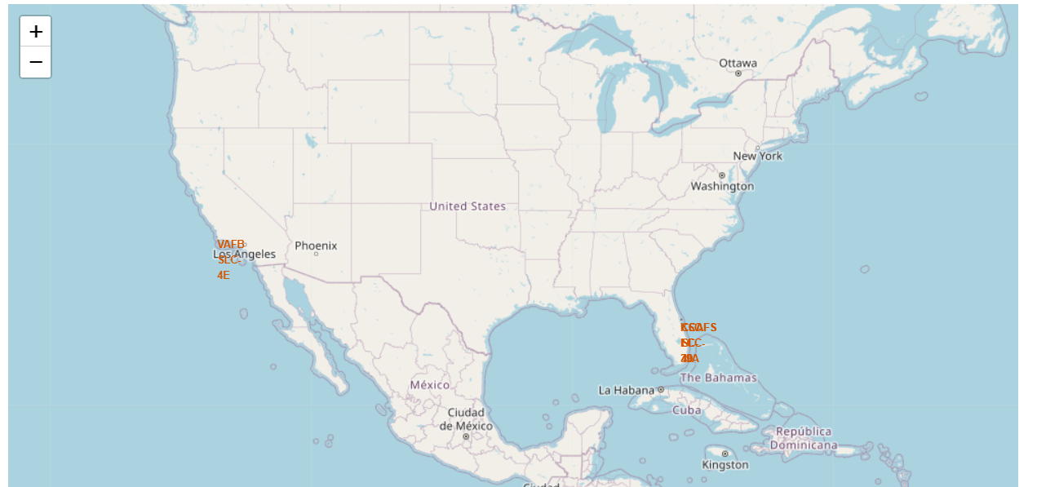
All Launch Sites
all the launch sites are near coastline.

Slide 39
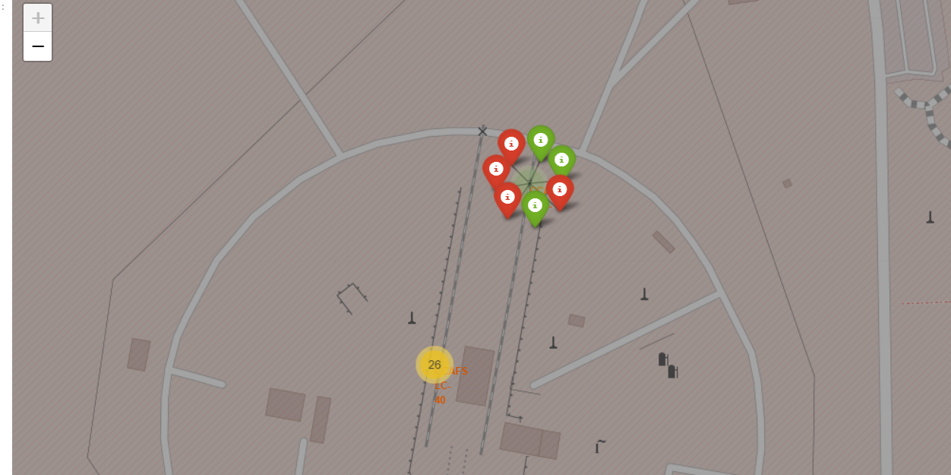
Launch outcomes
Green indicates success and red indicates fail

Slide 40
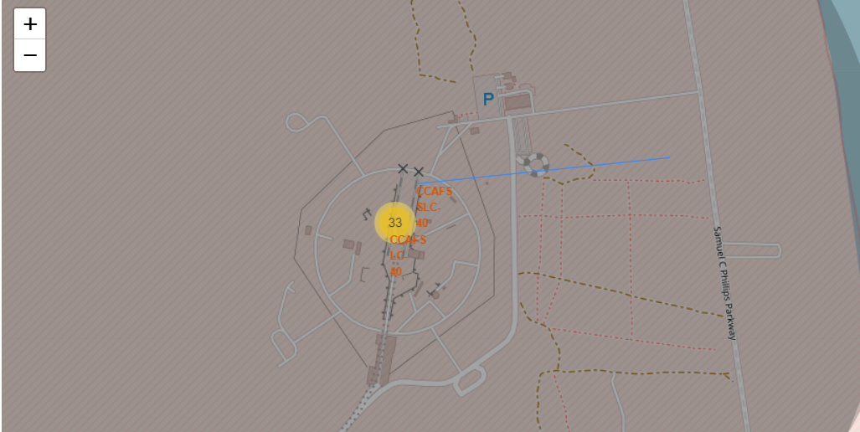
Lines and distances
Lines can be added to the map and coordinates can be used to get the distance.

Slide 41

Section 4

Slide 42
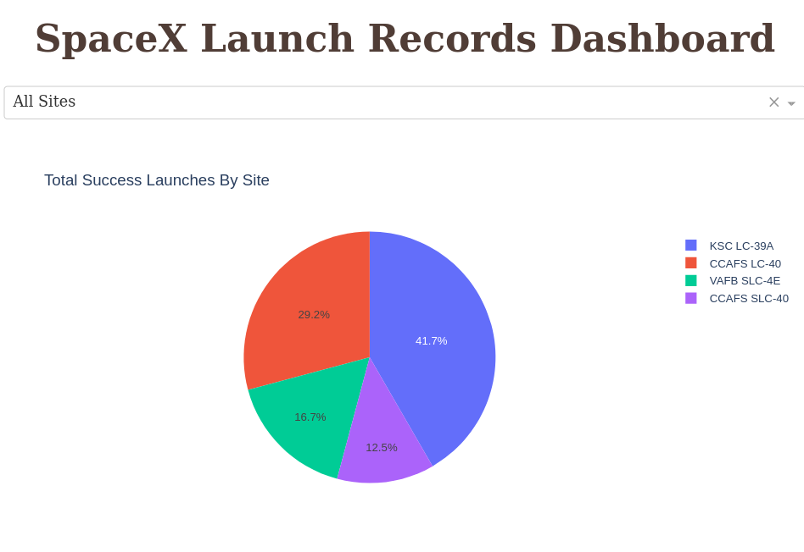
All Sites
By selecting all sites options, we can show all sites.

Slide 43
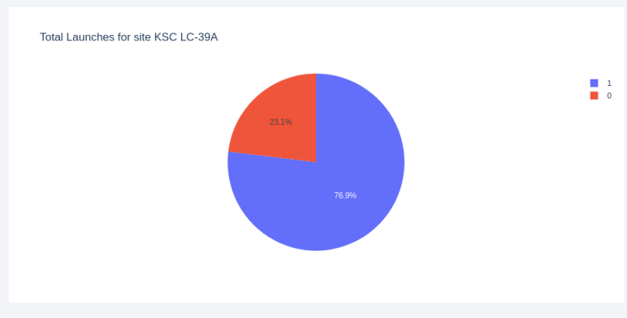
Launch Success Ratio:
Site KSC LC-39A have highest success rate with 76.9%

Slide 44
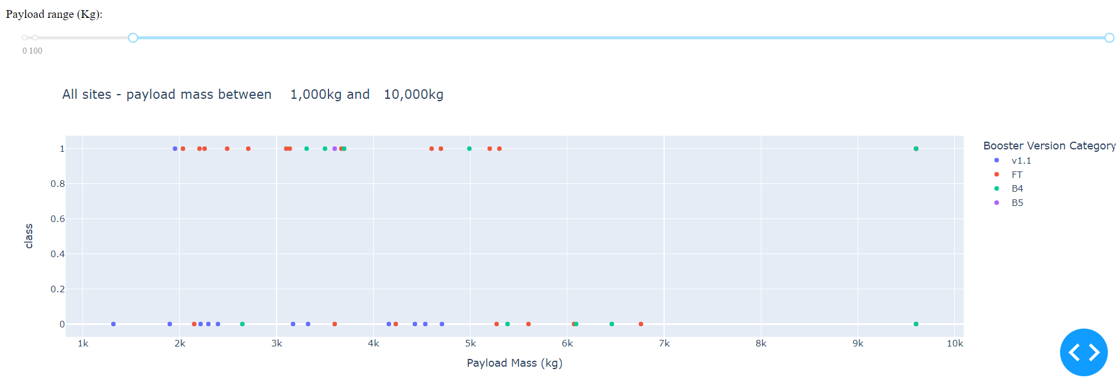
Pay load and launch outcome
Payload above 6000KG are not very successful.
Payload below 6000KG and FT booster are very successful

Slide 45

Section 5

Slide 46
Classification Accuracy
Here are the accuracies for 4 classification models used.
Performance of all models are close.
Decision tree classification may have overfitting as training accuracy is much better that test accuracy.

Slide 47
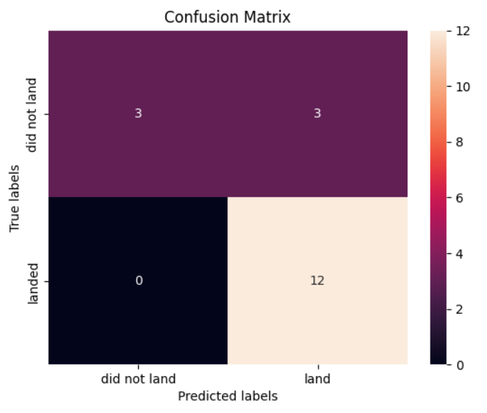
Confusion Matrix
Here’s the confusion matrix of logistic regression model, it was able to predict all landed cases successfully.
For ‘did not land’ cases, it was able to predict only half of it.

Slide 48
Conclusions
Data from different data sources were analyzed, refining conclusions along the process.
The best launch site is KSC LC-39A with 76.9% success rate.
Launches with below 6000KG payload and FT booster are highly successful.
Most of the mission outcomes are successful.
Landing outcome improved significantly over years.

Slide 49
Appendix
All the codes are present in below github repository: https://github.com/harshalingala/datascience_capstone_project

Slide 50


